Slide 1
Kaessmannlab Wiki
wiki.kaessmannlab.org

Slide 2
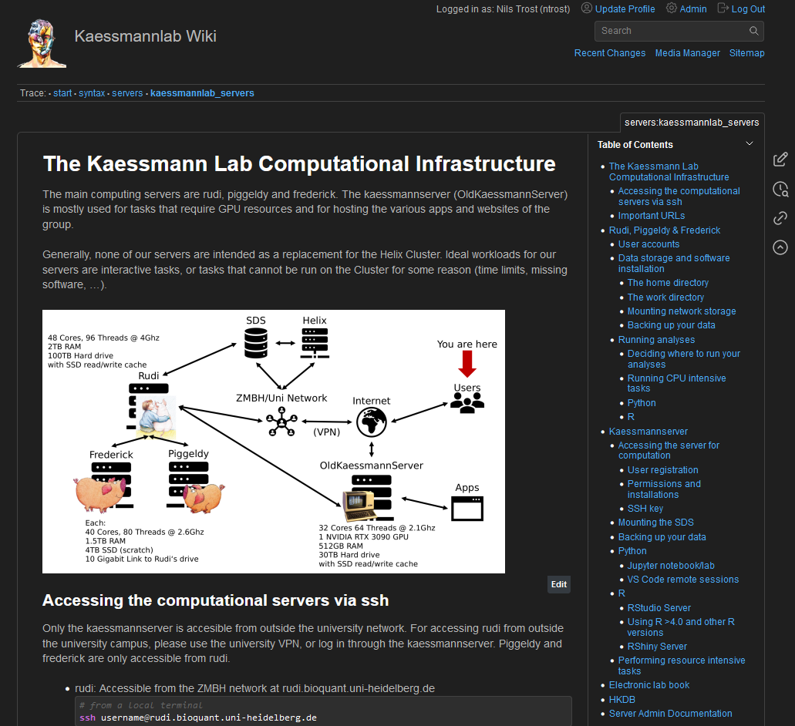
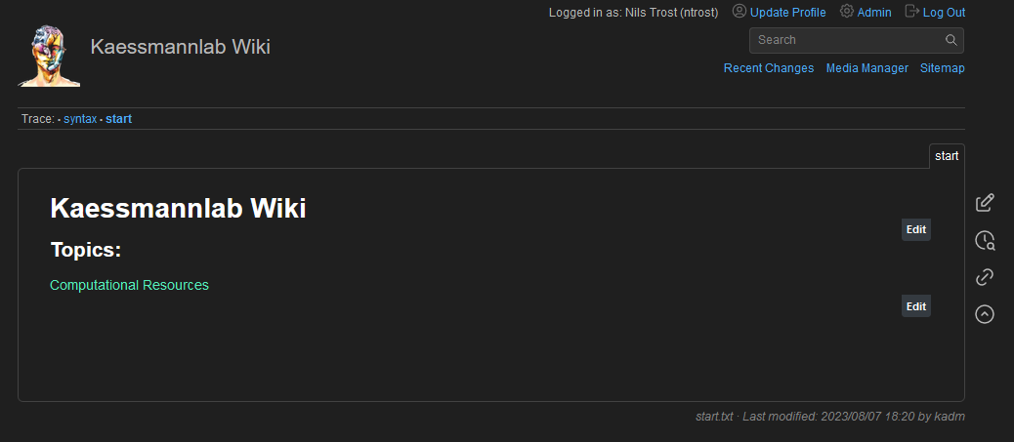
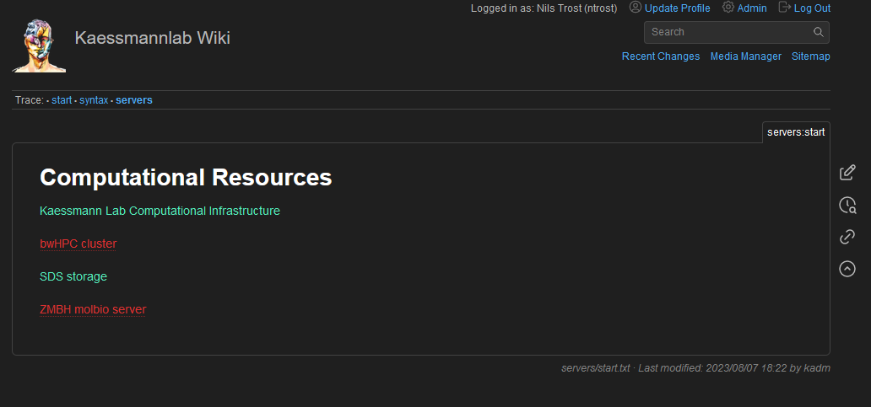
Current state of the wiki (17.04.2024)
There is a landing page with currently one link
Information on how to use the servers is already there
Previously server_usage.pdf
Information for server administrators

Slide 3
Edit pages

Slide 4
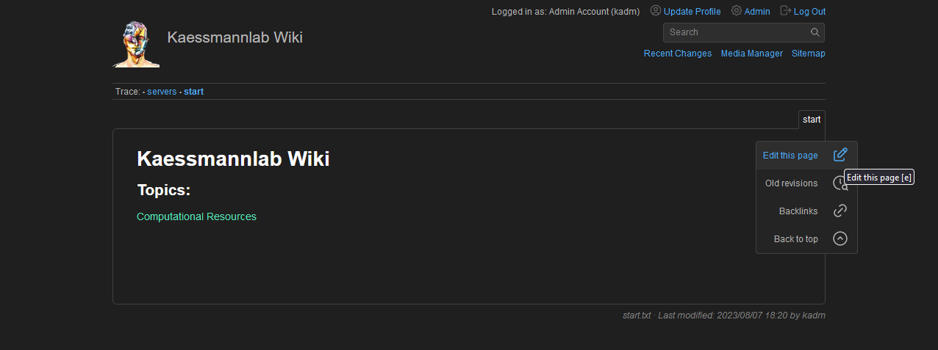
Edit pages

Slide 5
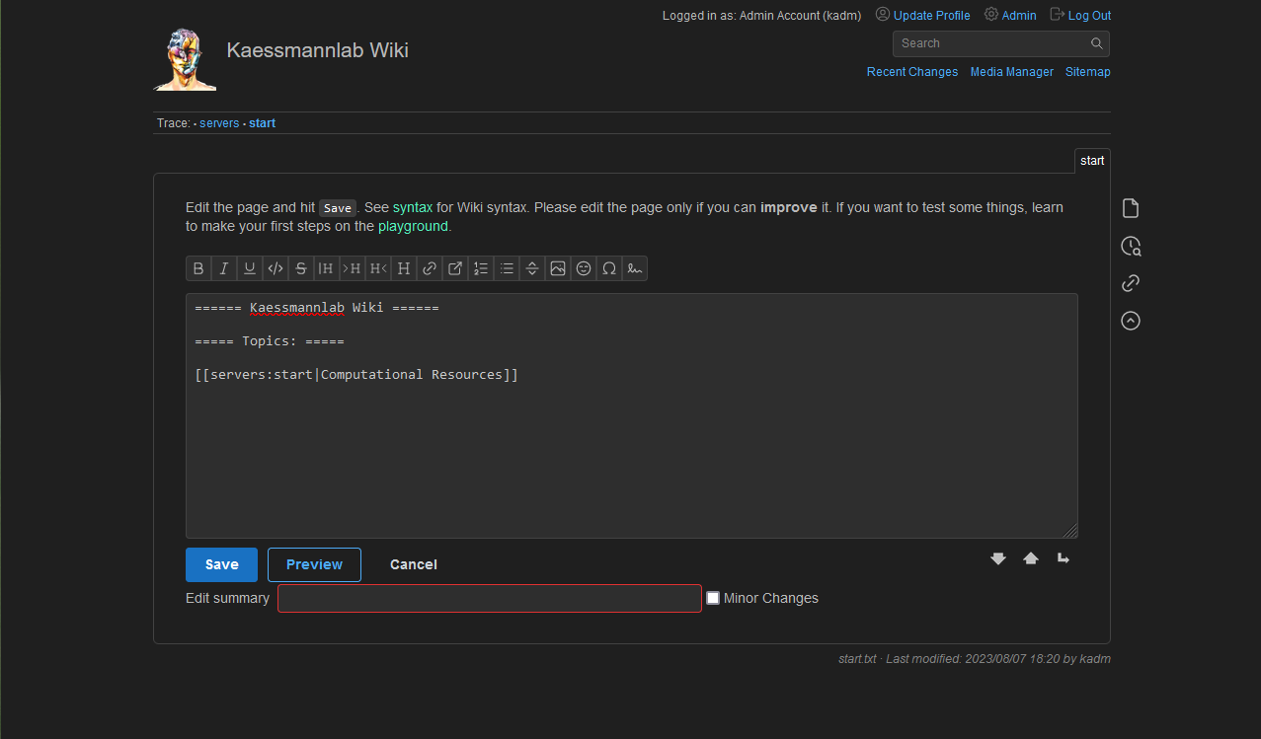
Edit pages

Slide 6
Edit pages
Formatting

Slide 7
Edit pages
Headings

Slide 8
Edit pages
Links (internal, external)

Slide 9
Internal link to existing page
External link
Internal link to non-existing page

Slide 10
Edit pages
Preview the changes, add a description of the changes and save

Slide 11
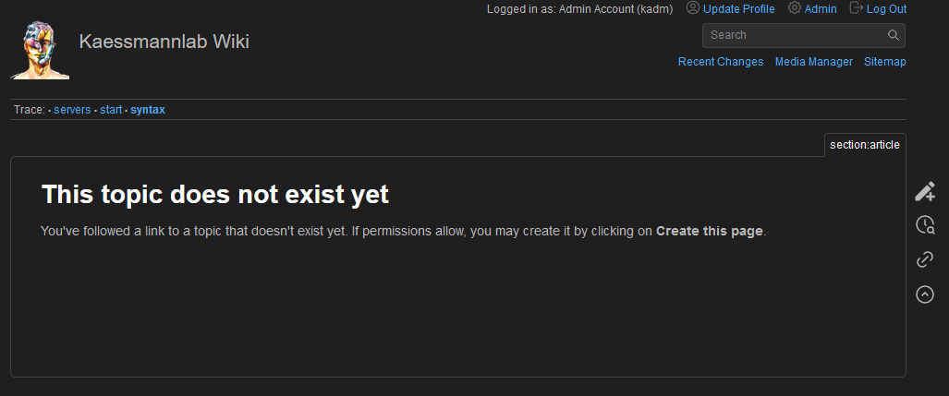
Creating a new page
Just create a link from an existing page to a new (non-existing) page.
After saving, you can click the link which will take you to the new page, from where you can edit it.

Slide 12
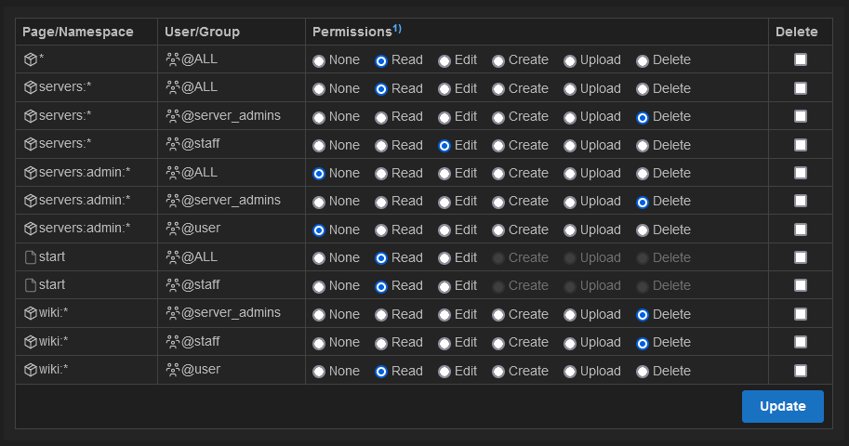
Organising the wiki into sections (namespaces)
To avoid potential naming conflicts and to better manage editing rights
When creating a page link, use “:” to separate namespace name and page name
lab:start
lab:protocols:start

Slide 13
More information
DokuWiki Webpage: https://www.dokuwiki.org/DokuWiki
Syntax: https://wiki.kaessmannlab.org/wiki:syntax

